Slide 1

Offering SOLUTIONS FOR BUSINESS NATIONWIDE SINCE 1998
Teams Up With

Slide 2
Who Is Capital bankcard
Nation Wide:
Over 80,000 Active Merchants
400+ Employees in Boston
12 Million Transactions per Month
$9 Billon Annual Processing Volume
A Recognized Leader in Payment Technologies

Slide 3
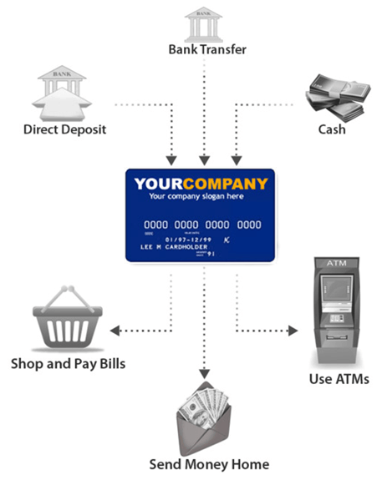
PrePaid Debit cards

Slide 4
Prepaid highlights
Cards can be funded by:
    Direct Deposit – Government Payments or Payroll
    Bank transfer – Transfer From Other Banks
    Cash – Add Cash to Cards
Cards Can be Used:
    Anywhere Prepaid Debit Cards Are Accepted
      Shops, Stores, Restaurants, Hotels, Etc.
    Make Online Purchases
    Get Cash From ATMs

Slide 5
Prepaid Highlights
Reduce Expense of Issuing Paper Checks
Conveniently pay People Who Don’t Have a bank account
Competitive solution enabling 100% electronic pay
Manage your program with online reporting tools
Depending on Final Program Selection – Cobranding Available
Widely accepted Visa®, MasterCard® or Discover® branded cards

Slide 6
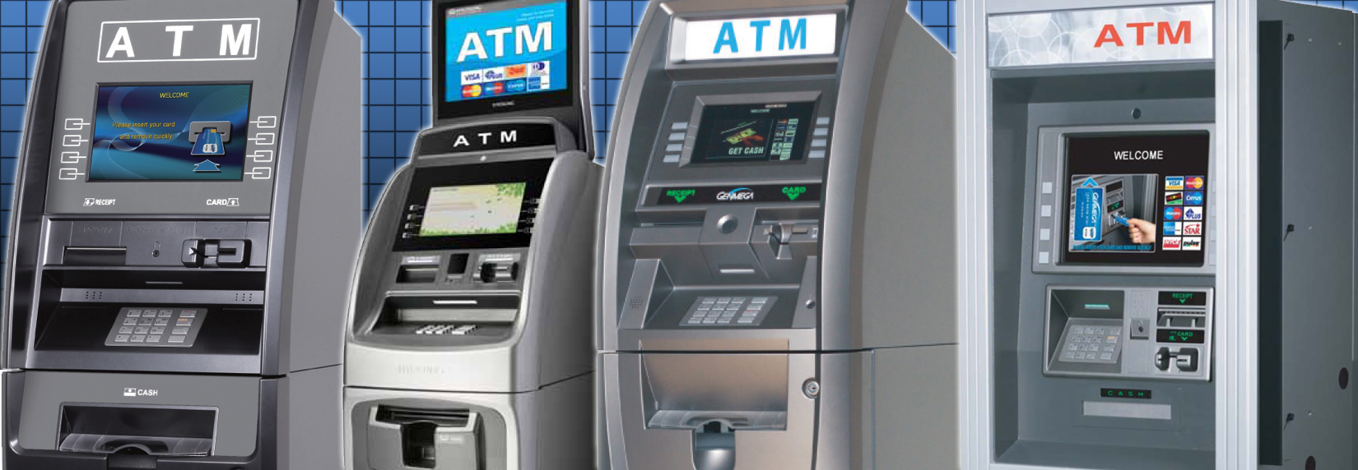
ATM Program
ATM placement in Your Locations & Provide Processing
We customize ATM in Your Brand, Warranty & Maintain ATMs
You Load Cash & Control ATMs
ATM Profits are Shared

Slide 7
Credit & Debit Card Processing
Solutions for any Business Need
    Retail stores & shops Hotels & Hospitality
    Restaurants Bars & clubs
    Grocery Mobile Businesses
    Fuel Stations Casinos
  POS Systems & Solutions
  Any Equipment Needs
  Internet Solutions & eCommerce Packages

Slide 8
Thank You!
We look forward to Discussing next Steps

