Slide 1


AmiraUSA - Brief
June 2016

Slide 2
Table of Contents
Introduction
Investment Package
Consulting & Integrated Services
Portfolio companies/ Corporate Partners
Contact Information

Slide 3
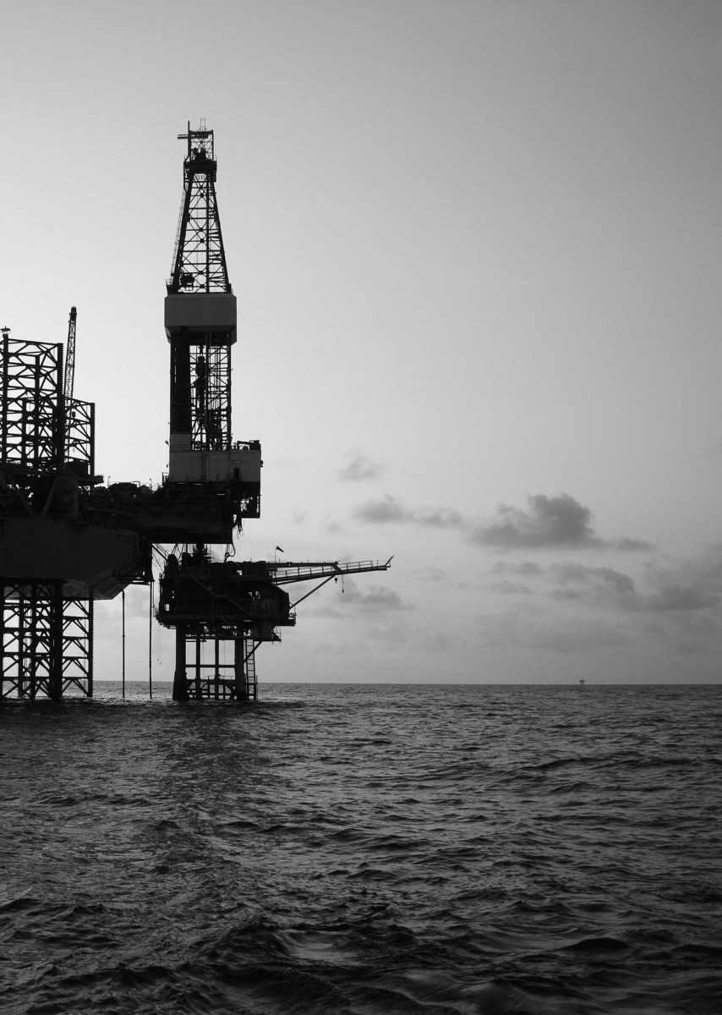
Triad Energy Partners, LLC
Investment solutions in the Energy Sector securitized by Sovereign and Bank Guarantees and Monetizing underground hydrocarbons
Deferred 7-15 years repayment plan
Borrowing and Lending Practices

Slide 4
Introduction
Built on years of experience, AMIRA specializes in offering guidance and growth in project management, finance, and development.
Our global network of offices and business relationships help us foster longstanding and broadly reaching partnerships. This enables us to provide comprehensive international project development services and continued returns through a diverse set of opportunities.
AMIRA has a number of major strategic Joint Venture Partnerships with leading International Companies. This dynamic portfolio helps leverage AMIRA Capital and resources into partnerships and Joint Ventures that can prove an asset to client companies as AMIRA is committed to growing and guiding.

Slide 5

Amira is a privately owned and operated company founded in 1966; the company assists businesses in navigating from project conception to sustaining positive growth via offering expertise in integrating established technology, developing connections and drawing upon cutting-edge research.
Our strategic alliances also provide capacity for hydrocarbon exploration and production, mining, electricity generation, housing, commodities trading and sourcing, and information technology.
AMIRA’s talented team will successfully capitalize on opportunities and ventures that demand a thorough understanding of business, technology and government to achieve our client's objectives.

Slide 6
AmiraUSA offers diverse services in areas of:
Financial advisory
Investments
Consulting on Business Development, Corporate Financing, Structuring, Strategies and delivering solutions towards capital growth objectives.
Assist in securing/and providing investment and funds for Capital to undertake large capital projects beginning from conception, execution and delivery.

Slide 7


Slide 8

AMIRA and industry Partners possess a strong and solid financial knowledge, investment expertise and capabilities coupled with strategic alliances with top international financial institutions, engineering and oil services companies.

Slide 9

Investment Package
  AMIRA in Partnership with Wall Street investors and hedge funds, is offering, a New Paradigm in Asset Backed Securitization Patented method of managing financial instruments, equipment lease derivatives and other collateral instruments, data architecture, application and process program.
  We can provide efficient consulting services towards securing the requisite investment and funds in support of capital projects.

Slide 10

Consulting and Integrated Services
Petroleum Product Sales
  We work with petroleum products suppliers and refineries in order to meet the needs of government and corporate clients. Our services support the efficient supply of petroleum products to both US domestic and international markets.
  AmiraUSA’s parent company, the Amira Group supplies gasoline (all grades), diesels (on road/off road), Jet fuel, D6, D2, ULSD and Marine Fuels. Amira is a 637 licensee registered with the IRS, activity letter “S” as a position holder/through-putter within the bulk terminal transfer system.
Drilling
  With our industry partners/drilling operators we offer consulting onshore and offshore turnkey integrated drilling services and maintenance.

Slide 11
Loans and Deferred Payment Financing
We provide advice and can work with our parent company Amira Group to utilize the use of State issued Sovereign Guarantee or Bank Guarantee format ICC 458, 500 or 600 to secure capital for industrial and infrastructure projects.

Slide 12
Credit Card Solutions & Services
With our industry partner we are able to offer a variety of Credit and Debit Processing Cards, Gift and Loyalty Cards, Electronic Check Conversion, Restaurant and Retail POS Systems, Credit Card Terminals, Mobile Processing, Cash Advance Programs, ATM Machines, Internet Solutions & eCommerce Packages.

Slide 13
Refinery Building and Refining
With our industry partners we have long-standing refining expertise. AMIRA has successfully delivered a number of refining projects throughout the world, ranging from conceptual, technical and economic studies to revamps, expansions and world-scale new build.
We deliver high quality, cost-effective solutions and offer large expert engineering resources available in the industry. This strength, coupled with our global network of engineering partners, allows us to mobilize large teams very quickly to meet the most demanding schedules.
Water Supply Systems
AMIRA partners with industry leaders to develop seawater and brackish water desalination systems and water management. The stationary, modular and energy-efficient desalination systems development has reached serious maturity and represents a sustainable concept for the world’s potable water supply.
Through our partners we provide; Solar Water Distillation and Distribution water reuse systems powered by renewable energy.

Slide 14
Electricity Generation Power Plants
AMIRA with our industry partners are a leading global provider of full-service, value-added EPC contractor and front end engineering and design, installation and commissioning, OEM provider of services and maintenance to include: Power plants and power generation services, Transmission lines, Step up Transformers, Sub-stations.
Renewable Energy Systems
AMIRA with our industry partners offer full service solutions, EPC contracting and OEM provider of services and maintenance to include: Solar industry systems, Solar housing systems, Thermal Solar, Steam systems, Street-lightning systems, Photovoltaic systems, Wind Energy.

Slide 15

Housing
  We offer from our developers’/builders industry partners’ network world Class award winning Panel and modular homes concepts designed for the poor and low-income families being embraced and supported by the United Nations Housing Programs in several countries. We also provide through our partners, master planned luxury developments
Commodities
  AMIRA with our industry partners offer Brazilian sugar deliveries on CIF basis at reduced prices.

Slide 16
Portfolio Companies/Corporate Partners
Amira Industries
GEPetrol/JVA Partner and Financial Mandate and Consultant
The National Oil Company of Equatorial Guinea
Newtech Industrial Group
Well Perform ApS
Kepis & Pobe
Oil blocks explorations and development worldwide
www.amiraindustries.co.uk
Oil blocks exploration and development
www.equatorialoil.com
Primary focus in the oil and gas and derivatives trading to include non-ferrous minerals and urea, engineering capabilities in refining projects and value added services (insurance, shipping and logistics)
www.newtech-group.com
Integrated oil and gas drilling and well services and maintenance Geothermal and Mineral Industries
www.wellperform.com
Oil blocks and gas field’s investment and development.
www.kepisandpobe.com
Power Generation Services, Inc
EPC power plants builder and services contractor
www.powergenerationservicesinc.com
Inglett & Stubbs, LLC
Commercial and residential electrical contractor and EPC power plants and power generation services contractor.
www.inglett-stubbs.com
Endaxi Capital Partners, Inc
Infra-structure and projects (refineries and power plants) capital investment.
www.endaxicapital.com
General Stability Inc.
Blackheart International
Tactical gear and Equipment
www.bhigear.com
Military, Law Enforcements and Civilians

Slide 17
Portfolio Companies/Corporate Partners
Alton-McLean Group
Drilling supervision and management integrated drilling and oil services.
www.altonmcleangroup.com
Legend Drilling and Workover Services
www.legenddrillingsa.com
Capital Bankcard
Credit Cards Solutions and Services
www.capitalbankcard.com
Abengoa (MCE: ABG)
Is an international company that applies innovative tech solutions for sustainable development in energy and environment sectors, generating electricity from the sun, producing biofuels, desalinating sea water or industrial waste recycling.
www.abengoa.com/www.befesaagua.es
Advanced Solar Photonics, LLC
ASP is leading manufacturer and R&D center of crystalline silicon PV modules, racking systems, grid-tied inverters, and complete solar kits for residential, commercial, and utility applications in US.
www.AdvancedSolarPhotonics.com
Alatec Group
Turnkey projects in architecture, consultancy construction, civil, industrial and environmental engineering.
www.alatec.es
Technokontrol
Safety products and services system.
www.technokontrol.com
Ommahealthcare
Hospital EPC contracting and health care services.
www.ommahealthcare.com
Pinhal Grupo Emresarial
Sugar plantation owners, processor and supplier.
www.grupopinhal.br

Slide 18
Portfolio Companies/Corporate Partners
Triad Energy Partners, LLC
Investment solutions in the Energy Sector securitized by Sovereign and Bank Guarantees, Monetizing underground hydrocarbons.
Freytech Inc
Oil/water separation and Eco-storm equipment.
www.freytech.com
Crosco-Delemas Amira Drilling Nigeria Limited
Integrated onshore and offshore drilling and oil well services and maintenance in Nigeria.
www.crosco-da.com
MTI Commodities (UK) Limited
Commodities trading and a major crude oil and petroleum products player, London, UK
Westpaq, LLC
Exploration and Production, Reservoir Evaluation and Management, Geology and Geophysical Evaluation.
www.westpaq.com
Quick Quarters, Inc.
Manufacturer and developer of high quality solutions for temporary structural needs. It offers unique containerized transportable and re-deployable structures for both public and private applications in domestic and foreign markets.
www.quickquarters.com
D&D-FRB Inc
Worldwide leading of prefabricated fast response buildings, dedicated to helping bring safe, secure and comfortable accommodation and fully integrated social infrastructure in the simplest fastest and most economic way possible. We do this ensuring the least environmental impact.
www.dnd-frb.com
Quick Aid
Multi use hemostatic badges stop bleeding in seconds
www.quickaid.com
Jonny Asmar
Top quality web design services and consulting in WordPress, SEO, ecommerce, and full-scale application development.
www.jonnyasmar.com
Deferred 7-15 years repayment plan
Borrowing and Lending Practices

Slide 19
Contact Information
AmiraUSA, LLC
Mark Asmar, CEO/Chairman
2101 L St., NW, Suite 800
Washington, DC 20037-1077, USA
Office: 202 467 8374
Direct: 202 536 2620
Mobile: 202 549 3009
Fax: 202 466 0502
Email: masmar@amirausa.com
www.amirausa.com

